Slide 1
LINUX AND SHELL SCRIPTING

Slide 2
Learning Outcomes
Understand the installation process of Linux
Understand the partitioning of hard drives

Slide 3
Booting
Booting is a bootstrapping process that starts operating systems when the user turns on a computer system.
A boot sequence is the set of operations the computer performs when it is switched on that load an operating system.

Slide 4
Booting sequence
Turn on
CPU jump to address of BIOS
BIOS runs POST (Power-On Self Test)
Find bootable devices
Loads and execute boot sector form MBR
Load OS

Slide 5
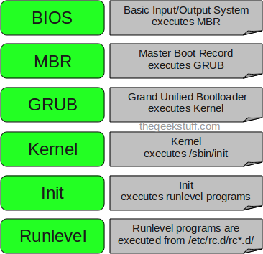
Booting sequence

Slide 6
BIOS (Basic Input/ Output System)
BIOS refers to the software code run by a computer when first powered on.
The primary function of BIOS is code program embedded on a chip that recognizes and controls various devices that make up the computer.

Slide 7
MBR (Master Boot Record)
OS is booted from a hard disk, where the Master Boot Record (MBR) contains the primary boot loader.
The MBR is a 512-byte sector, located in the first sector on the disk (sector 1 of cylinder 0, head 0)
After the MBR is loaded into RAM, the BIOS yields control to it.

Slide 8
Boot loader
Boot loader could be more adaptly called the kernel loader. The task at this stage is to load the Linux kernel
GRUB and LILO are the most popular Linux boot loader.

Slide 9
Other boot loader (Several OS)
GRUB
LILO
GRUB2WIN
BOOTCAMP
BOOTKEY
NTLDR
Syslinux

Slide 10
GRUB: GRand Unified Bootloader
GRUB is an operating system independent of boot loader.
A multiboot software packet from GNU.
Flexible command line interface.
File system access.
Support multiple executable format.
Support diskless system.

Slide 11
LILO: LInux LOader
Does not depend on a specific file system.
Can boot from harddisk and floppy

Slide 12
Task of kernel
Process management
Memory management
Device management
System call

Slide 13
Init process
The first thing the kernel does is to execute init program.
Init is the root/parent of all processes executing on Linux.
The first processes that init starts is a script /etc/rc.d/rc.sysinit.
Based on the appropriate run-level, scripts are executed to start various processes to run the system and make it functional.

Slide 14
The Linux Init Processes
The init process is identified by process id “1”.
Init is responsible for starting system processes as defined in the /etc/inittab file.
Upon shutdown, init controls the sequence and processes for shutdown.

Slide 15
Download Linux
To install Red Hat, you will need to download the ISO images (CD Images) of the installation CD-ROMs from http://fedora.redhat.com
Download the i386 images for 32 Intel Processors, PPC images for for Apple Macintosh and x86_64 for 64 bit AMD Processors.

Slide 16
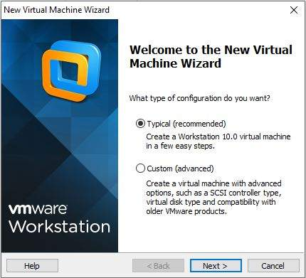
New Virtual Machine Wizard

Slide 17
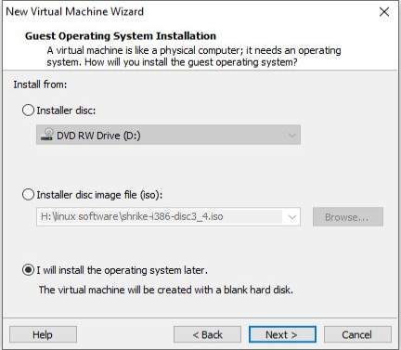
Installation of operating system

Slide 18
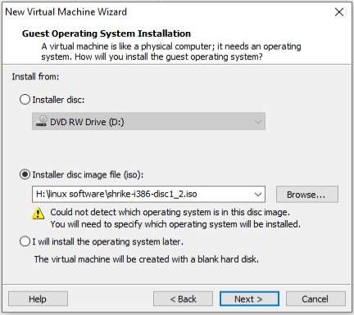
Installation of operating system

Slide 19
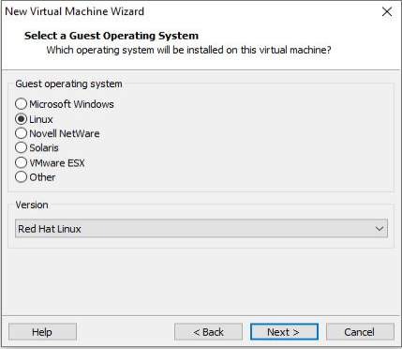
Installation of operating system

Slide 20
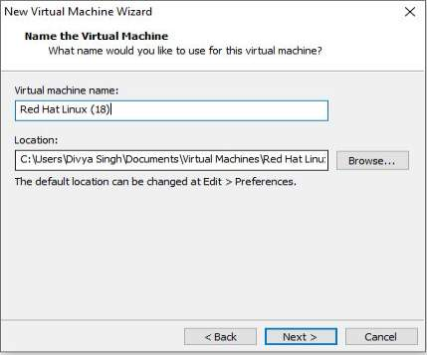
Installation of operating system

Slide 21
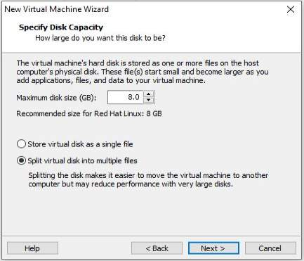
Specify disk capacity

Slide 22
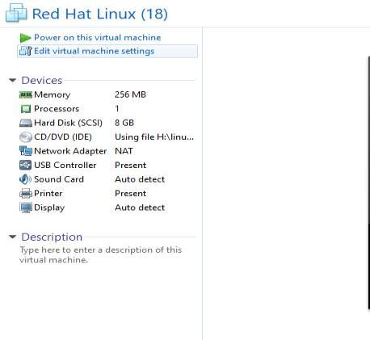
Installation of operating system

Slide 23
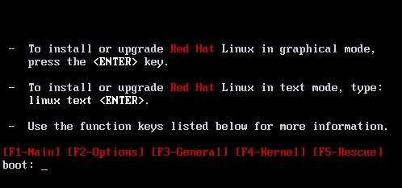
Installation of operating system

Slide 24
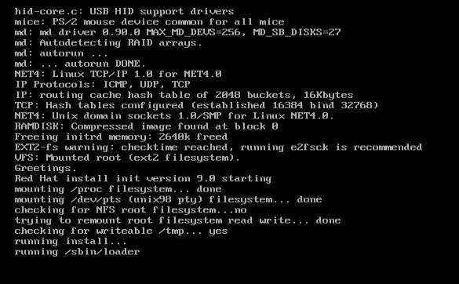
Installation of operating system

Slide 25
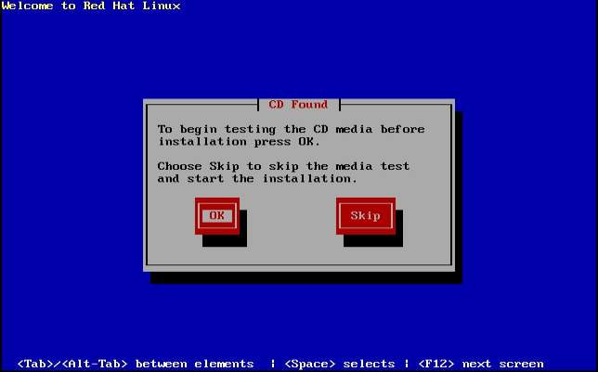
Testing the CD Media

Slide 26
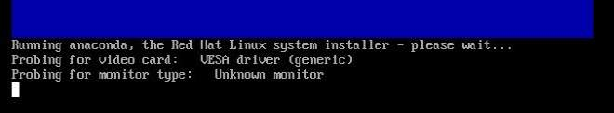
Running Anaconda

Slide 27
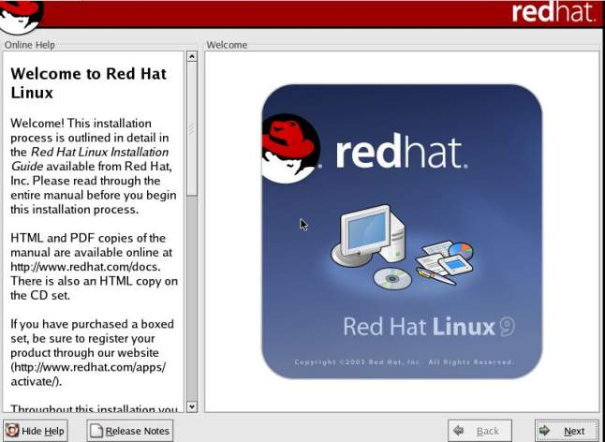
Installation of operating system

Slide 28
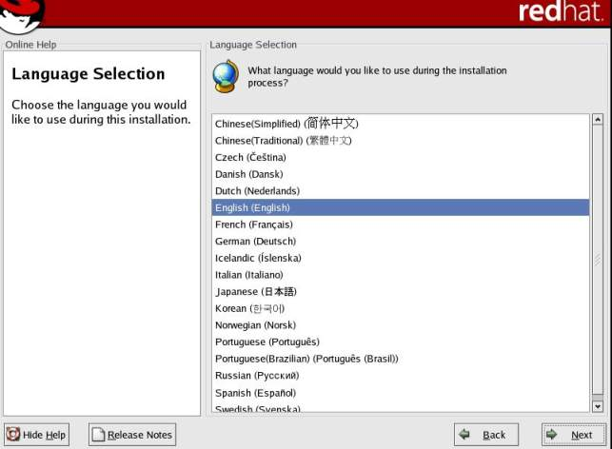
Language Selection

Slide 29
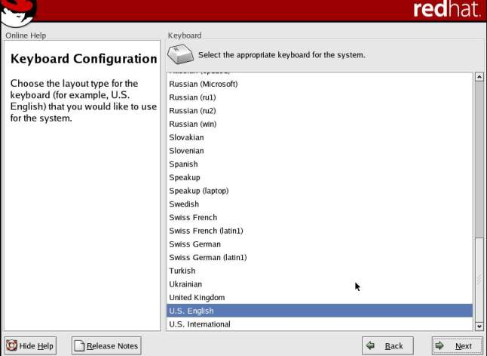
Keyboard Configuration

Slide 30
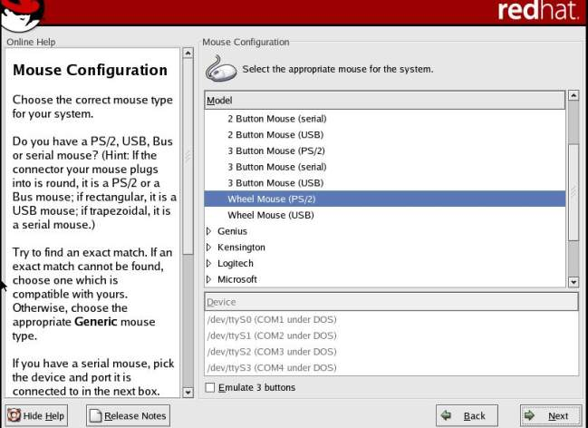
Mouse Configuration

Slide 31
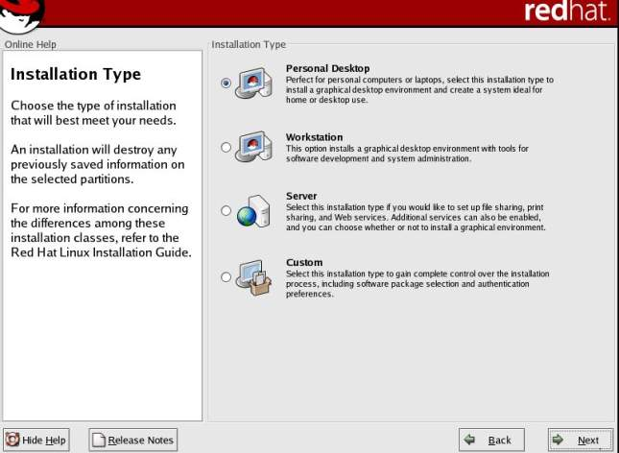
Installation Type

Slide 32
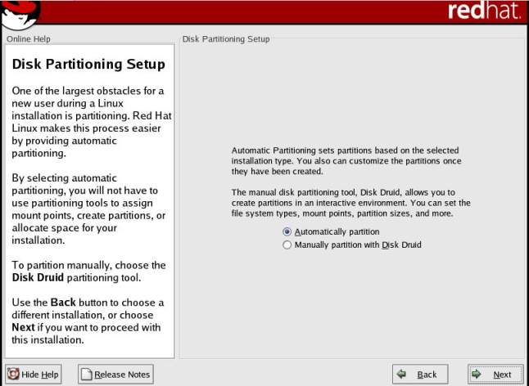
Disk Partitioning Setup

Slide 33
What is a partition?
Partitioning is a means to divide a single hard drive into many logical drives.
A partition is a contiguous set of blocks on a drive that are treated as an independent disk.
A partition table is an index that relates sections of the hard drive to partitions.

Slide 34
Partition Fields
Device: This field displays the partition's device name.
Start: This field shows the sector on your hard drive where the partition begins.
End: This field shows the sector on your hard drive where the partition ends.

Slide 35
Partition Fields
Size: This field shows the partition's size (in MB).
Type: This field shows the partition's type (for example, ext2, ext3, or vfat).
Mount Point: A mount point is the location within the directory hierarchy at which a volume exists; the volume is "mounted" at this location. This field indicates where the partition will be mounted.

Slide 36
Filesystem Types
ext2 — An ext2 filesystem supports standard Unix file types (regular files, directories, symbolic links, etc). It provides the ability to assign long file names, up to 255 characters. Versions prior to Red Hat Linux 7.2 used ext2 filesystems by default.
ext3 — The ext3 filesystem is based on the ext2 filesystem and has one main advantage — journaling. Using a journaling filesystem reduces time spent recovering a filesystem after a crash as there is no need to fsck the filesystem.

Slide 37
Filesystem Types
swap — Swap partitions are used to support virtual memory. In other words, data is written to a swap partition when there is not enough RAM to store the data your system is processing.
vfat — The VFAT filesystem is a Linux filesystem that is compatible with Windows 95/NT long filenames on the FAT filesystem.

Slide 38
Recommended Partitioning Scheme
Unless you have a reason for doing otherwise, it is recommended that you create the following partitions:
/boot partition – contains kernel images and grub configuration and commands
/ partition
/var partition
Any other partition based on application (e.g /usr/local for squid)

Slide 39
Recommended Partitioning Scheme
swap partition — swap partitions are used to support virtual memory. In other words, data is written to a swap partition when there is not enough RAM to store the data your system is processing. The size of your swap partition should be equal to twice your computer's RAM.

Slide 40

Disk Partitioning Setup

Slide 41
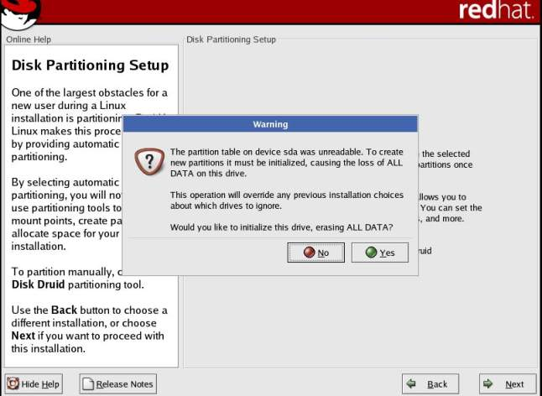
Disk Partitioning Setup

Slide 42
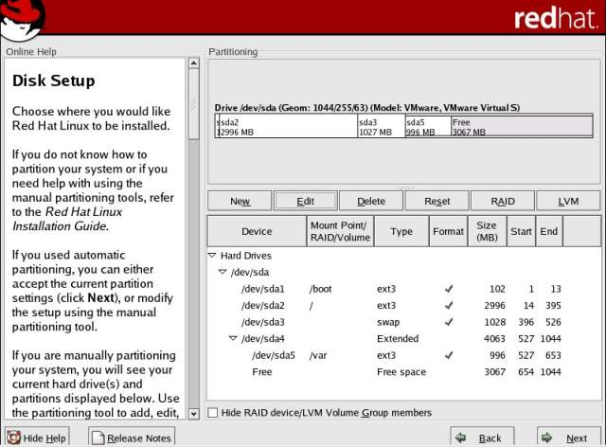
Disk Partitioning Setup

Slide 43
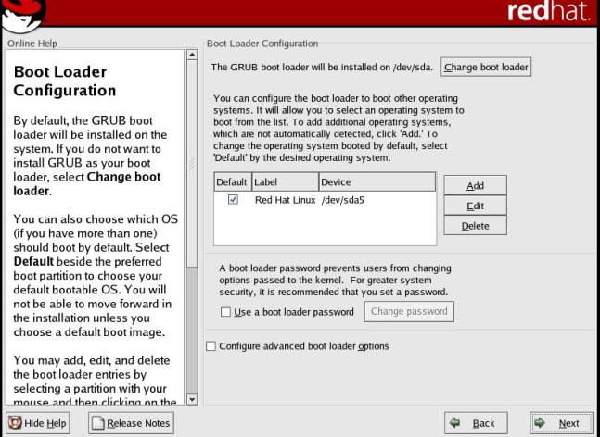
Boot Loader Configuration

Slide 44
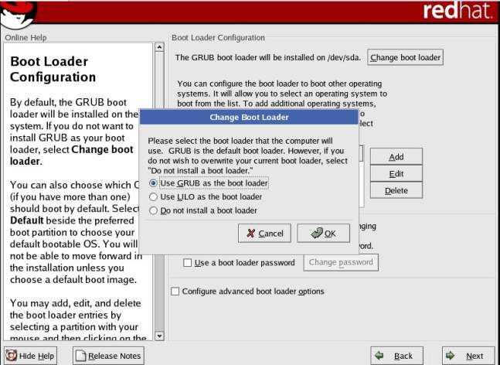
Change Boot Loader

Slide 45

Change Boot Loader

Slide 46
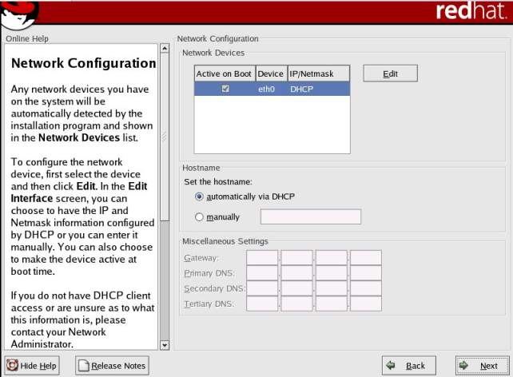
Network Configuration

Slide 47
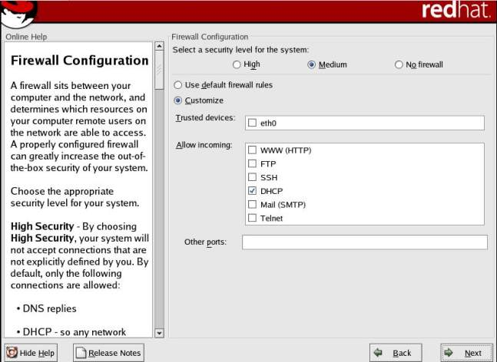
Firewall Configuration

Slide 48
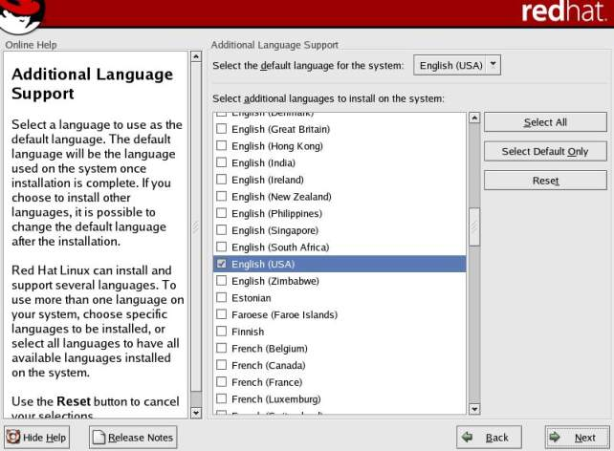
Additional Language Support

Slide 49
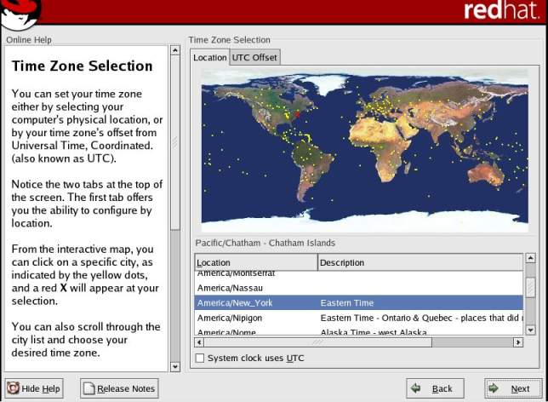
Time Zone Selection

Slide 50
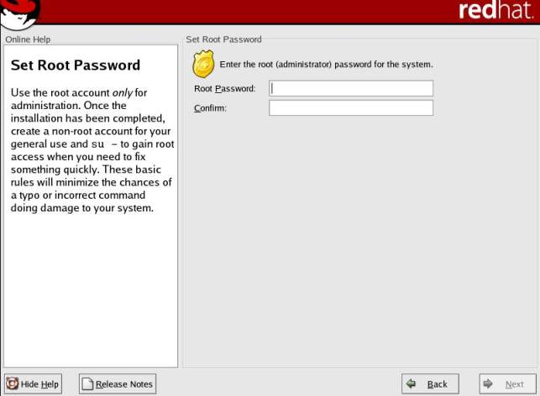
Set Root Password

Slide 51
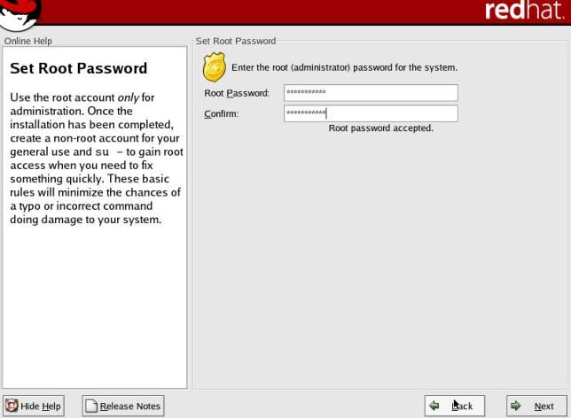
Provide Root Password

Slide 52
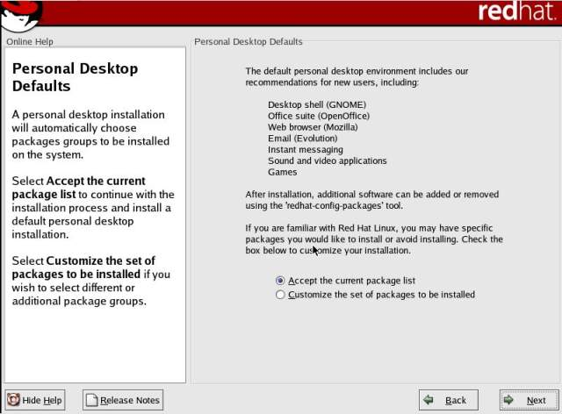
Personal Desktop Defaults (Packages)

Slide 53
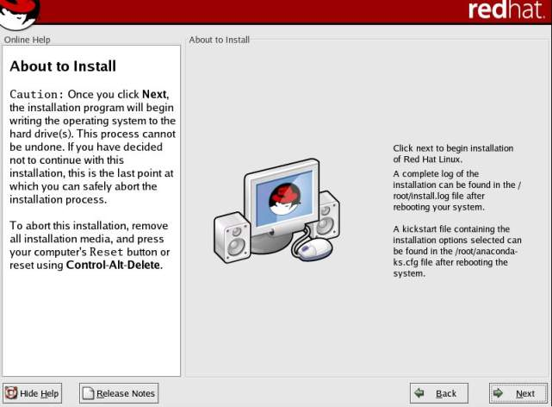
About to Install

Slide 54
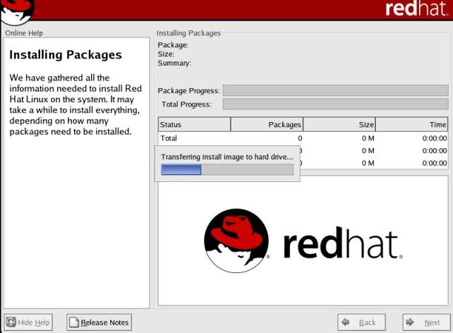
Installing Packages

Slide 55
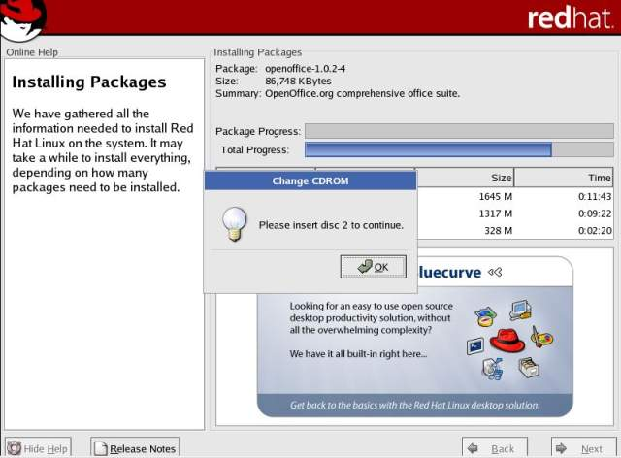
Insert Disc 2

Slide 56
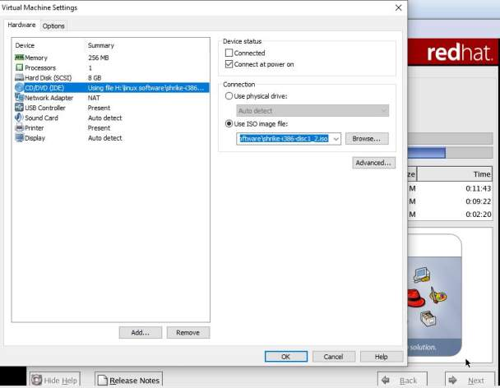
Use ISO Image

Slide 57
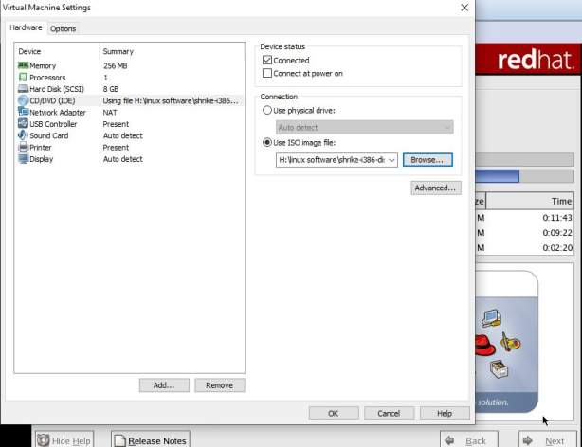
Proper Settings

Slide 58
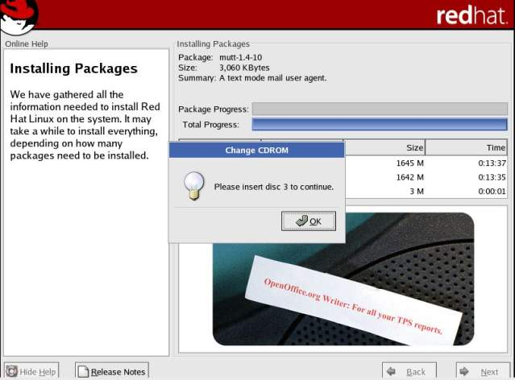
Insert Disc 3

Slide 59
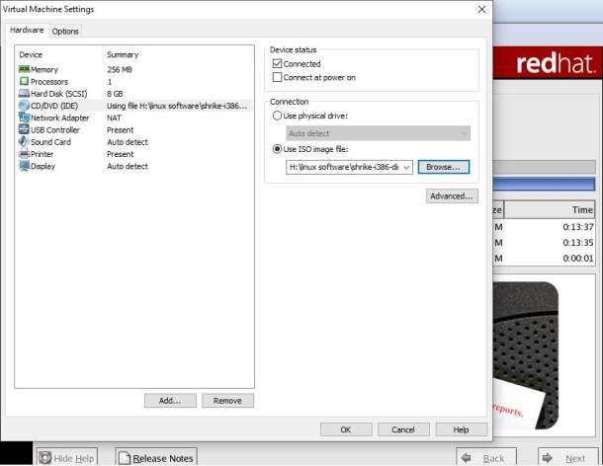
Proper Settings

Slide 60
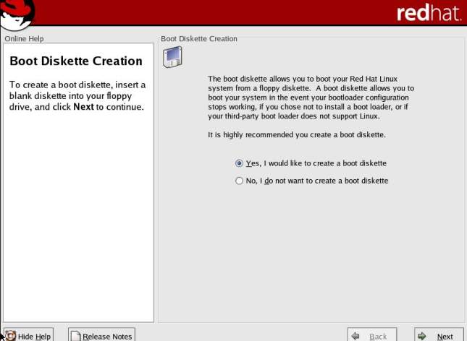
Boot Diskette Creation

Slide 61
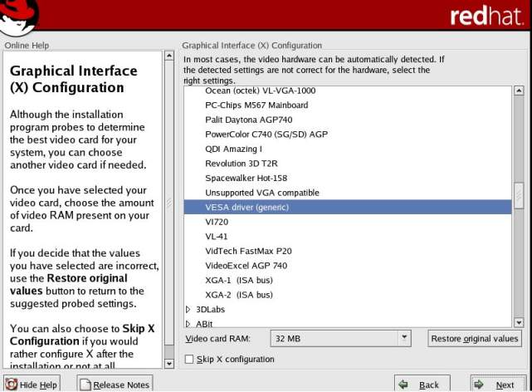
Graphical Interface (X) Configuartion

Slide 62
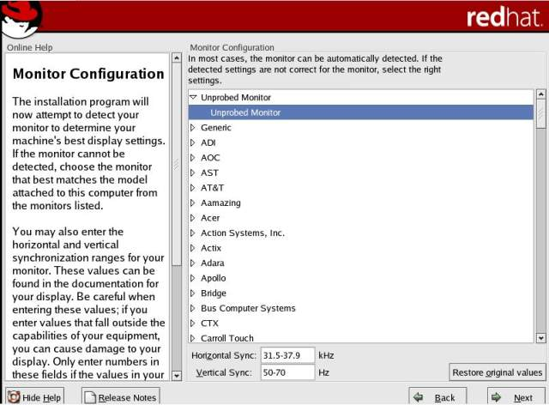
Monitor Configuration

Slide 63
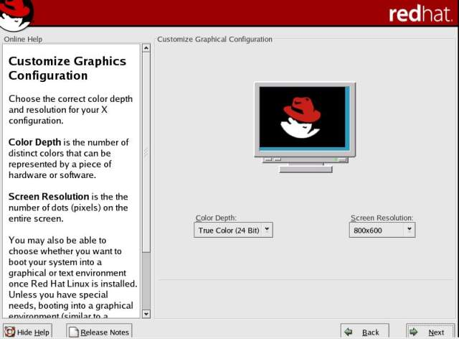
Customize Graphics Configuartion

Slide 64
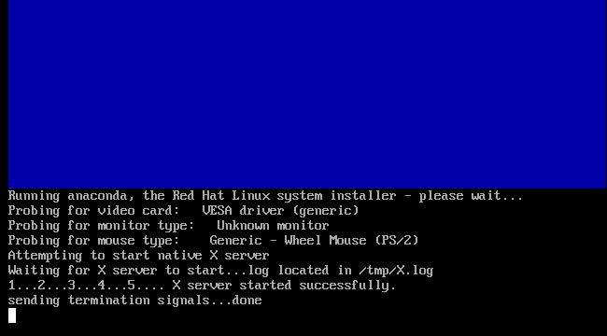
Installation

Slide 65
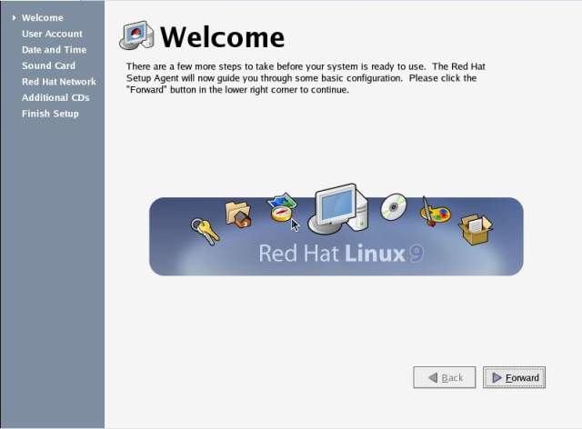
Welcome

Slide 66
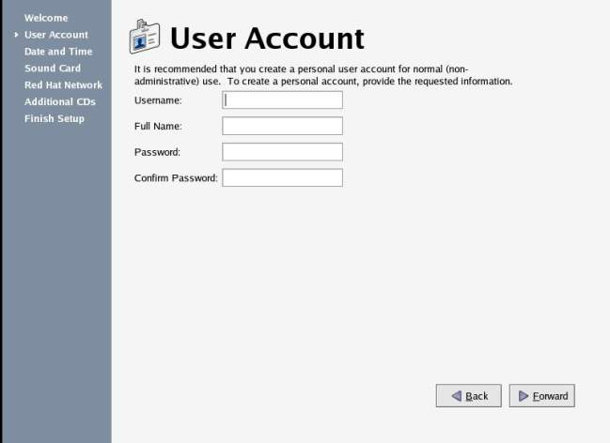
Creation of User Account

Slide 67
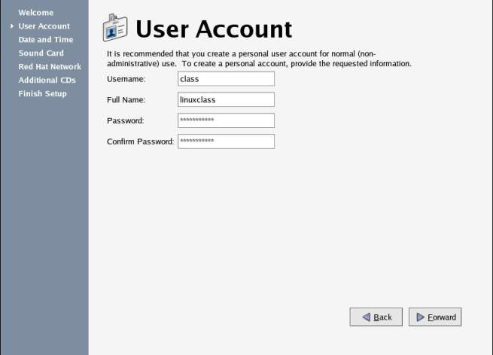
Enter Credentials

Slide 68
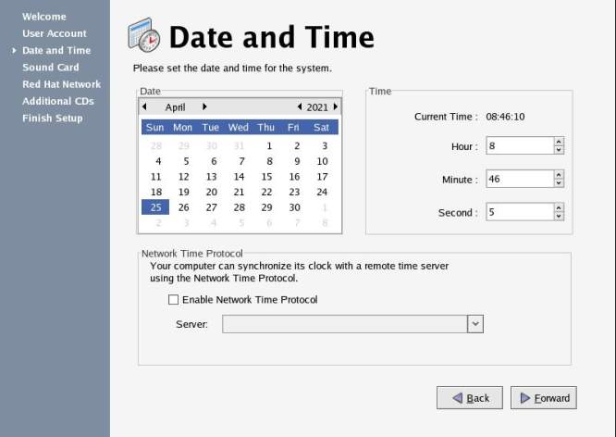
Enter Date and Time

Slide 69
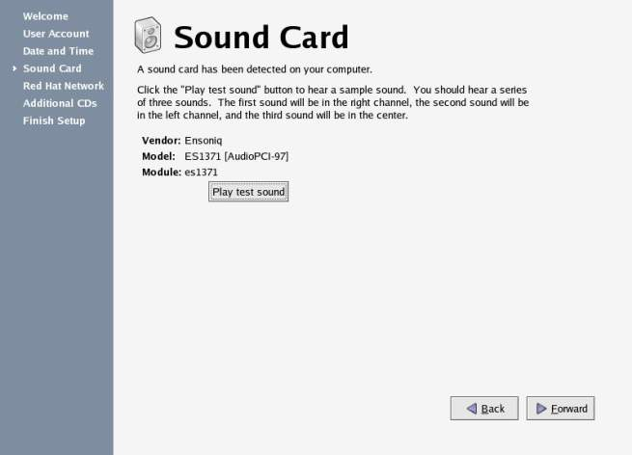
Sound Card

Slide 70
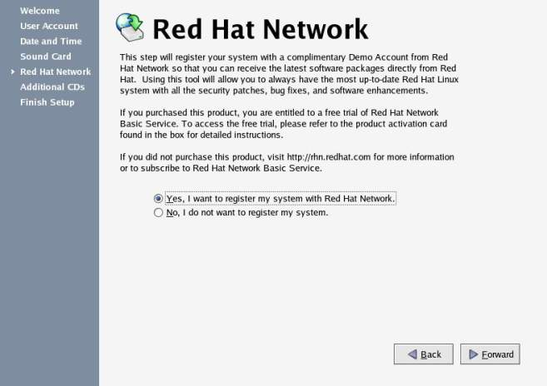
Registration with Red Hat Network

Slide 71
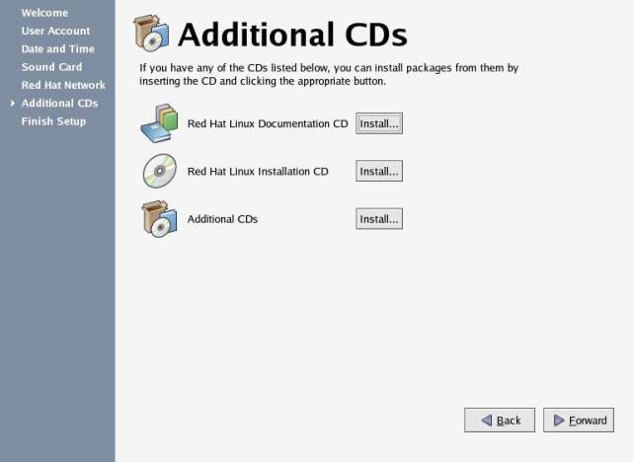
Installation of packages from additional CDs

Slide 72
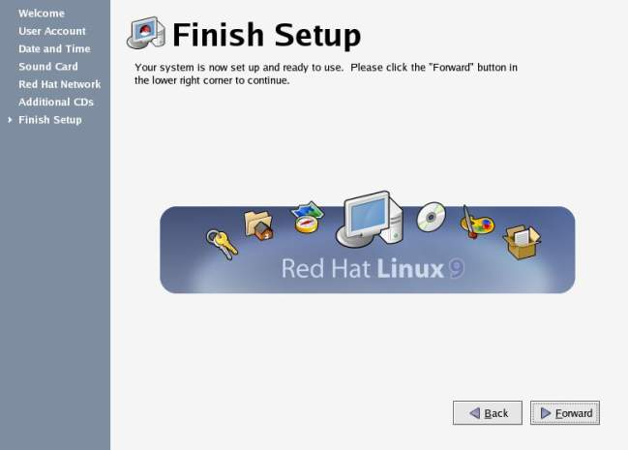
Finish Setup

Slide 73
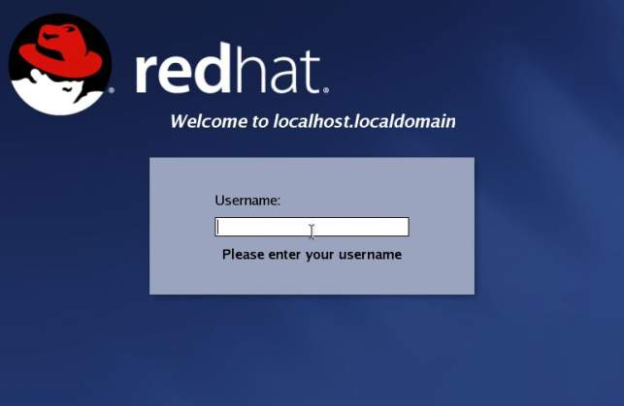
Logging in

Slide 74

Home Screen

Slide 75
Moving around the Desktop
GNOME: The default desktop interface of Red Hat linux 9.
KDE: KDE desktop is included in Rec Hat Linux 9 distribution but not installed by default.

Slide 76
Components of Desktop
Panel
Workspace

Slide 77
Runlevels
A runlevel is a software configuration of the system which allows only a selected group of processes to exist
Init can be in one of seven runlevels: 0-6

Slide 78
Runlevels
Runlevel | Scripts Directory (Red Hat/Fedora Core) | State
0 | /etc/rc.d/rc0.d/ | shutdown/halt system
1 | /etc/rc.d/rc1.d/ | Single user mode
2 | /etc/rc.d/rc2.d/ | Multiuser with no network services exported
3 | /etc/rc.d/rc3.d/ | Default text/console only start. Full multiuser
4 | /etc/rc.d/rc4.d/ | Reserved for local use. Also X-windows (Slackware/BSD)
5 | /etc/rc.d/rc5.d/ | XDM X-windows GUI mode (Redhat/System V)
6 | /etc/rc.d/rc6.d/ | Reboot
s or S |  | Single user/Maintenance mode (Slackware)
M |  | Multiuser mode (Slackware)

